Slide 1

Growth Fundamentals Framework Philosophy
The design behind the framework...

Slide 2
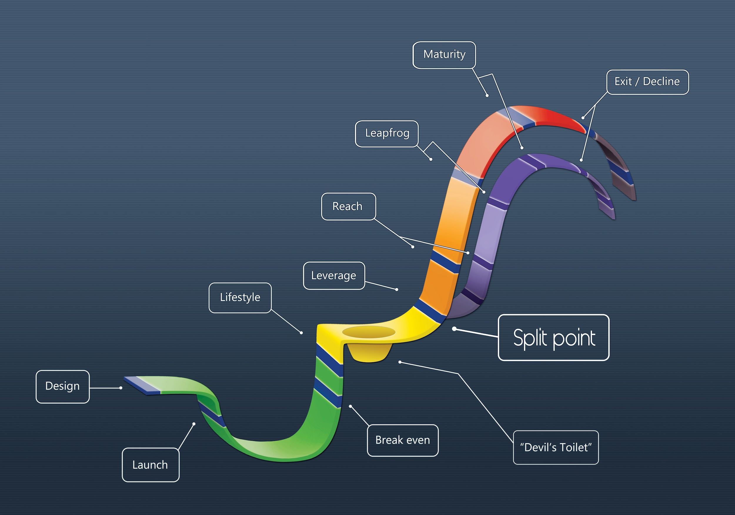
Growth Fundamentals Framework

Slide 3
Growth Fundamentals Philosophy
Fun-Da-Mental:
...forming or relating to the most important part of something; serving as a basis supporting existence or determining essential structure or function. (Webster Dictionary Source)
The following pages are designed to help you (the advisor) communicate the need for ‘fundamentals’ to be present in a business, prior to major steps of expansion.
Human nature tends to push us towards the need for ‘new and fresh’; we’re quick to move on once we ‘know something’ but the key is to determine (at each business level) Do we truly understand it?, do we do it consistently? And, are we doing it well? (Have we mastered it?)
What follows are our thoughts as to the Fundamentals that should be mastered and present within a business prior to new growth steps being taken. Please take the information and ‘make it your own’.
Change anything you like, but be ‘robust’ in your decision making as this will form the substance (foundation) of your delivery as an advisor.
Good luck, and enjoy!
Mike & David.

Slide 4

The Concept of Growth Stage Fundamentals
The life ‘Growth Stages’ of the business are placed on a ‘Sigmoid-type/Sine Wave-type’ Curve’ as it’s representative of the Regenerative, Recurring aspects of growth in all living things.
Before expansion can occur, there must be a period of dormancy; of homeostasis. The organism must ‘re-group’ itself prior to expending its energy in pursuit of gain.
The curve is representative of both ‘gravitational forces’ in terms of its shape and form and ‘frictional forces’ in terms of the colours used.
The higher you climb on the curve, the greater the energy required; the greater the risks and the greater the resistant forces trying to pull you back down.
Each ‘Growth Stage’ along the curve requires new Mindsets (focus and confidence for example), Skill Sets, Resource and Actions (habits) in order to meet the challenges of business ‘at that level’.
Growth is a philosophy; it’s a fundamental requirement of life but it only emerges AFTER the conditions and sustenance are present. You can’t work on growth; only the inputs that contribute to growth...

Slide 5
What’s in the Name?
Growth - (maintaining or developing) is often the key focus of business owners.
Fundamentals – (that which is) critical to support existence or determine essential structure or function.
Framework – the Designed Structure that guides future actions or form.

Slide 6
Why do we Need a Framework?
Frameworks help to guide (and Capture) the thinking, the observation, the reflections and the actions of those striving for excellence.

Slide 7
What does the Framework DO for your Client?
Creates Self Relevance.
(This is critical for both learning and developing the motivation to want to act)

Slide 8
How does the Framework create Self Relevance?
Establishes Context
(Recognition of ‘where you are’ based on knowing ‘where you’ve come from’ and ‘where you’re headed’)

Slide 9
Growth Fundamentals Framework (Advisor component purpose)
Component | Advisor Purpose
9 Growth Stages | Identify Current Position
5 Layers of Complexity | Identify Dominant Psyche Error
7 Growth Focus Tactics | Identify Next Tactical Focus
Devil’s Toilet | Recognise Profit Plateau Levels
Split Point | Recognise Missing Skill Sets
9 Growth Aspects | Maintain Balanced Awareness

Slide 10
Growth Stage | Growth Stage Description
Exit/Decline | The business owners realise their capital gain via ‘going-concern’ sale or MBO to ‘groomed staff’/Succession to family members. (If successful) OR The business dwindles as the owner/s seek retirement. (If they missed the mark)
Maturity | The business now commands a sizeable market-share and creates a ‘barrier to entry’ for any business looking to compete against it.
Leapfrog | The business now enjoys the ability to purchase or merge with ‘like-minded’ competitors. Market share is now substantial...
Reach | The business is now enjoying multiple locations as the ‘brand’ is beginning to spread. New (additional) products are also part of your world!
Leverage | The business can sustain the lifestyle of the owner/s without the owner/s being directly ‘hands-on’ on a daily basis.
Lifestyle | The business makes enough profit to allow the owner/s to draw sufficient funds to meet their lifestyle and save money each month.
Break-even | The business makes enough money to cover costs.
Launch | Opening the doors and sharing your dream with the world!
Design | Developing your business concept, getting ready to leave your job!

Slide 11
What Got You Here... | Growth Stage | What Holds You Back...
Recognition that either the business has ‘outgrown you’ or it’s opportunistic to realise the ‘good-will’ you’ve created with both customers and staff alike. | Exit/Decline | Failure to have developed inherent value beyond that of your own personal involvement. Perhaps lack of vision for ‘life after business’..?
Vision, Discipline and a willingness to adapt to the needs of your business and marketplace; combined with a sound knowledge of financial and business fundamentals. | Maturity | Lack of financial management expertise; focus shifted from being customer centric to becoming absorbed with internal and ‘political’ issues. Lost ‘contact’ with the marketplace.
Sound business model with clarity of your customer’s drivers and the opportunity for ancillary services/products. Opportunity to capture market share with alternative distribution. | Leapfrog | Lack of understanding of the ‘Epistemology’ behind your potential alliance or acquisition partner combined with fragile Governance protocols. (Perhaps numerics ‘just don’t add up’?)
Proven systems and market acceptance of product/service combined with brand awareness in local marketplace. Key staff capable of ‘stepping up’. | Reach | Lack of knowledge around ‘consumer dynamics’ as they relate to the new marketplace or product/service that you plan to adopt.
Recognition of market demand (potential) and the need to meet it in order to stay competitive, combined with desire to have business less reliant on owner/s. | Leverage | Lack of faith in Key Staff (may be well founded) combined with poor delegation/visibility/review procedures. Perhaps a reluctance to ‘let go’ or a business model built around the ‘specialist’ service provider model. Governance ethos is not yet ingrained throughout.
A clear understanding of the value you offer your customers and the financial awareness of ‘what makes a difference & what doesn’t’... | Lifestyle | Lack of clarity around your business numerics or lack of discipline in completing the tasks that matter, on time.
Significant work and effort combined with a strong focus on customer delivery. | Break-even | Lack of financial management or sales/marketing basics, strained resources and fatigue...
Determined to ‘have a go’ and armed with enough supporting information to believe ‘it’s possible’... | Launch | Realisation of the task enormity and financial risks of failure. Perhaps legitimate timing or resource obstacles.
Frustrated with current income, lack of autonomy or time freedom combined with the desire to ‘see what you’re capable of’... | Design | Current job security and fear of the unknown. Times of complete clarity and sense of purpose clashed with doubt and resource fears...

Slide 12
The 5 Layers of Complexity + ‘The Common Psyche Error’
Complexity Layer | Layer Description | Common Psyche Error
Succession | Principles that give rise to understanding The Separation of Value & Worth. “Learning to get out of your own way” | (Trying to Avoid) Over-Identification
Expansion | Principles that give rise to understanding the Chaos of Interdependency and Affect. “There’s a fine line between Expansion and Explosion” | (Trying to Avoid) Over-Exposure
Intelligence | Principles that give rise to Contextual Awareness “Learning to Notice What You Don’t Know” | (Trying to Avoid) Optimism Bias
Orientation | Principles that give rise to understanding Your Purpose & Meaning. “Knowing Your Why & How” | (Trying to Avoid) Complacency
Foundation | Principles that give rise to understanding How things Work. “Being Curious – Open Heart & Open Mind” | (Trying to Avoid) Confirmation Bias

Slide 13
Psyche Error Drivers & Manifestations
Psyche Error | Drivers & Manifestations
(Trying to Avoid) Role-Identification | Identification is the psychological phenomenon by which people ‘Ascribes to oneself, the qualities or characteristics of another person’. Role Identification may involve the mimicking of a specific mentor or aspirational figure but it may also be the ‘acting out’ of the Ego to appear consistent with one’s own super ego ideals. In effect, people start acting how a ‘Boss’ should; in whatever they believe the circumstance requires. How they dress, what they drive, the way they treat subordinates etc. are all ‘manufactured’ to appear consistent with ‘appearances’. This manifests in poor decision making or the inability to ‘get out of their own way’ which is often viewed as being inauthentic. This is more evident during times of planned succession since the ‘business person’ has replaced the ‘person’ and the feelings of the ‘lost self’ are now very confronting. What will life after work look like? Who will value my opinion...?
(Trying to Avoid) Over-Exposure (Mere-Exposure Effect / Familiarity Principle) | The mere-exposure effect is a psychological phenomenon by which people tend to develop a preference for things merely because they are familiar with them; this is sometimes called the familiarity principle. The effect is driven by a desire to allocate ‘Cathexis Energy’ towards new (current) or perceived (future) threats rather than challenging what is known. The known is safe (hence the term “better the devil you know...”) but the future represents fear or challenge; this is even more tiresome if you challenge the known at the same time! In business this is supported by the “this is how we’ve always done it” phrase. Additionally (in businesses with existing scale) it relates to an avoidance of commitment or attempts to minimise exposure. This manifests in actions of ‘Keeping What We Have’ rather than focusing on ‘Achieving What We Need’. (Nokia and Kodak are classic examples of this principle)
(Trying to Avoid) Optimism Bias | Optimism is in response to life/death instinct which is born out of the thought processes of ‘mental time travel’. The ability to imagine the future is critical for our survival, it allows us to plan ahead, save food and resources for times of scarcity and endure hard work in anticipation of a future reward. However, the ability to view our long term future also allows us to consider our own death; so we’ve learnt to practice Hope & Faith as a means of re-directing our mental energy. The negative manifestation of Optimism Bias is that we seek to delete all NEGATIVE information in an attempt to ‘hold on to what we’ve got’ EVEN IF IT SUPPORTS OUR EXISTING BELIEF. In effect, we can learn information but choose to ignore it even if we believe it to be true, if it threatens our attachments or security. (This differs from confirmation bias where we accept all information in support of current beliefs and act accordingly)
(Trying to Avoid) Complacency | Complacency is driven by the mind’s (and body) requirement to recover after sustained periods of mental and physical exhaustion. Freud discussed the notion of Cathexis Energy (a combination of physical and emotional energy being consumed via neurotransmitter & electrical activity) as being our life force or ‘Libidinal Energy’; it’s what drives us. From time to time we need to rest and in business this is often prevalent upon reaching a stage of perceived security. The negative manifestation of this is the inability to maintain attention and focus on the external environment or ‘proven’ internal processes; especially when owners seek to extract themselves from day to day activities. (which is entirely consistent with the next growth tactic – Leverage)
(Trying to Avoid) Confirmation Bias | One of the key drivers of confirmation bias is ‘Cognitive Dissonance’. (reality not aligned with desires) In an attempt to avoid feeling anxiety we search for information (or shared views) to support our current view, so that we are less confronted by our ‘True Reality’. This manifests into us avoiding the truth and repeating same (or similar) mistakes (behaviour) whilst suppressing our growing fears. This is perfectly normal when establishing a business since we are taught that clarity and singular focus are essential elements of our own success; we can therefore be misguided into thinking that we’re not ignoring reality but instead, maintain focus on our goals. (This should be a clue since our goals are the same desires for which our reality is yet to be aligned...)

Slide 14

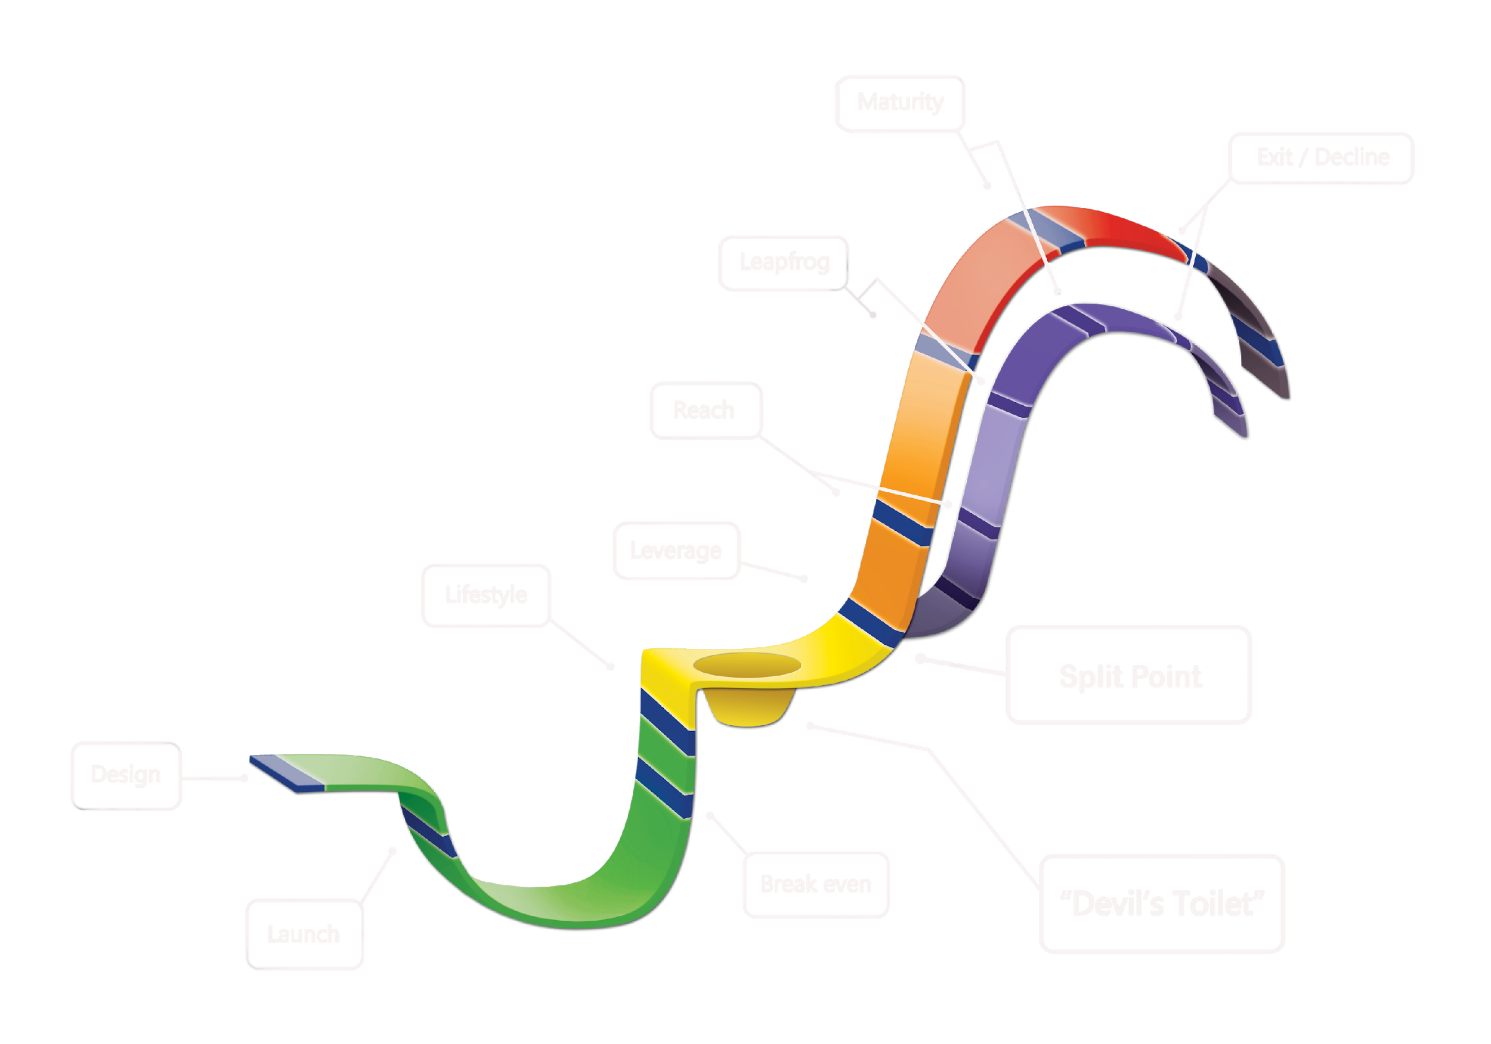
7 Growth Focus Tactics
Growth through Presence & Scale
Growth through
Realisation
(Succession)
Growth through Alliances & Acquisition
(Expansion)
Growth through Market Extension &
Product Divergence
Growth through Delegation,
Replication or Quantification
(Intelligence)
Growth through Clarity & Strategy
(Orientation)
Growth through Enthusiasm
& Creativity
(Foundation)

Slide 15
The 7 Growth Focus Tactics Explained...
Growth through Market Extension & Product Divergence
Market extension & Product divergence is about ‘finding greater revenue to feed your machine’. It’s a natural consequence of your business expanding after you’ve Leveraged your activities, via the steps explained in the previous level. All living things require ‘EXPANSION’ as part of their growth cycle; your business is no different. The inability to find additional ‘sustenance’ to meet your new ‘consumption requirements’ will, as in all living things, stunt your long term growth. This is a precarious stage as you are literally forced to confront new frontiers either in the form of new markets (physical) that are unknown to you, or, new products. This, combined with the previous LEVERAGE activities (prior) requires a major mind set shift for the business owner/s.
Growth through Delegation, Replication or Quantification
Delegation is the ability to dissect your activities/procedures such that a team member can complete SOME of the process. Much like how a surgeon employs a nurse to deal with more minor applications, freeing the surgeon to do a greater number of complicated procedures. Replication is the ability for a team member to do ALL of the task or, the ability to automate or reproduce an item with relative ease. Quantification is the ability to ‘magnify’ your value by multiplying the number of people you engage with or the fee you charge. (or both). You can of course, apply a combination of all 3 to achieve Leverage.
Growth through Clarity & Strategy
‘Clarity & Strategy’ is about the business owner realising that ‘sometimes, less is more’. It’s about identifying the difference between being a great artisan vs. a great business owner and it’s the natural time for the owner/s to step back and reflect on past efforts, learn from the good and the bad, and identify the new focus and activities required for the business to grow. It’s about thinking first, doing second.
Growth through Enthusiasm & Creativity
‘Enthusiasm & Creativity’ is all about the business owner ‘pushing hard’. It’s about having a general idea or vision for the business, but the focus is on ‘putting their head down and doing the hard yards’. This is an essential component for any business success as momentum (and subsequent learning via observation and reflection) can never be achieved without this focused effort. It’s about the ‘fun’ of being in business’.

Slide 16
The 7 Growth Focus Tactics Explained...
Growth through Realisation of Investment in Self, Team and Business/Processes.
All living things die in the end; it’s just the terms of the demise that’s ‘up for grabs’. Whilst exiting the business may not be seen as ‘Growth’ by some, it does in fact require significant personal growth of the business owner to step out of an organisation that they personally identify with. The successful sale of a business is dependant on expectations of growth by at least one of the parties; the more demonstrable this is, the easier to quantify the value to both parties. Therein, growth must be as central to every aspect of business culture within the organisation as possible; you can’t ‘stage an impression of growth’ as you dress for sale, it must be part of everything you’ve ever done in your business.
Growth through Presence & Scale
Presence & Scale is the goal of many living beings; the perceived strength and security is alluring but again, with size and position comes increased attack from others that seek the resource you consume. Maintenance and consistency is key here, as is discipline and awareness as it’s easy to become complacent and arrogant. Communication lines are essential and requires that it flows ‘both ways’. This is the stage that a quality Chairman or CEO shows their form, connecting and aligning teams to ‘stay on alert’ is primary. (this is definitely not a time to relax)
Growth through Alliances & Acquisition
Alliances and Acquisition is well described by the term ‘Leapfrog’ as you’re effectively using the skills and resource (primarily distribution & market penetration) to achieve the expansive growth necessary to meet current consumption or future growth needs. Whilst the previous level provided threats of a ‘knowledge based nature’, this stage provides equally as disruptive threats in the form of ‘human nature’. Much like a marriage, these steps are surrounded by optimistic emotions and are far easier to ‘get into than to get out of’. Understanding the difference between compromising and collaborating is critical at this level; far too often people ‘go along to get along’ out of fear of damaging early relations. This simply sets the scene for future ‘personality clashes’ and ‘political games’.

Slide 17
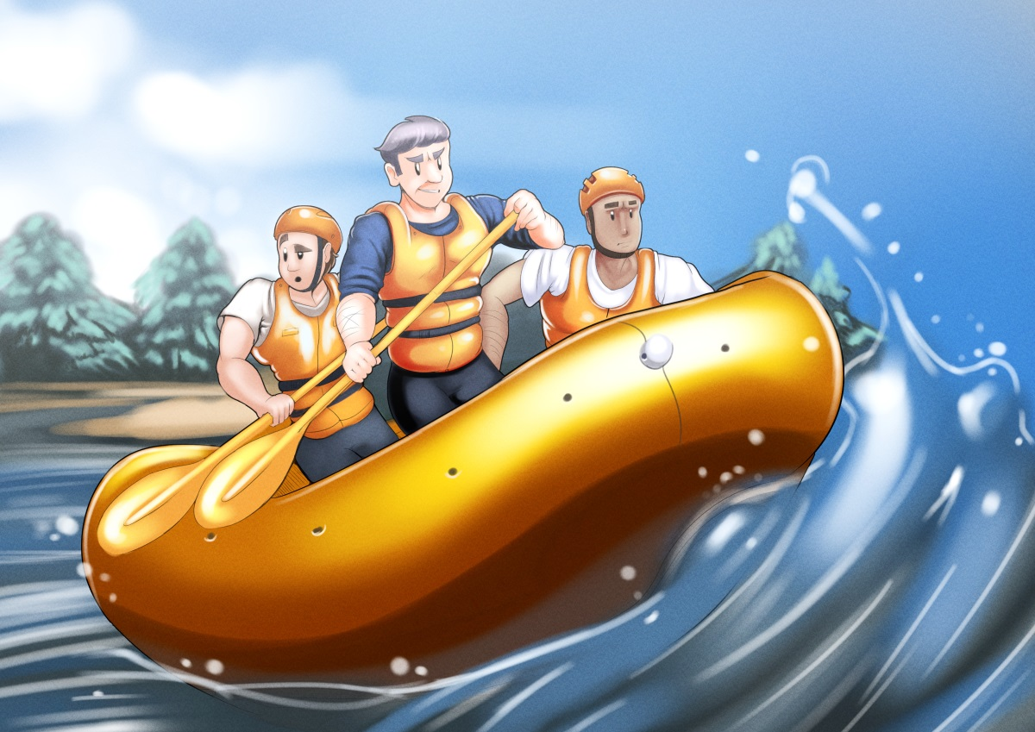
Growth Fundamentals – ‘The Devil’s Toilet’
The ‘Devil’s Toilet’ is a well known rapid on the Zambezi river which requires careful navigation, else it will ‘suck you in backwards’ as you attempt to raft a course to avoid it.
The ‘Devil’s Toilet’ in business growth terms is not unlike the Zambezi rapid... As you centre your attention on the path or tasks ahead you must remain aware of the ‘pulling and sucking forces’ that try to knock you off your chosen course.
Recognising that business growth involves elements of scale is critical to your success; we refer to them as Profit Plateau Levels and they’re like a series of rapids in that they don’t always appear ‘above the surface’. Just like the Zambezi river however, they will provide serious challenges that will confront you many times throughout your business journey.
Each business stage could be viewed as another dangerous rapid but nowhere is this more treacherous than between the stages of ‘lifestyle to leverage’. A high degree of complacency can exist here; combined with the potential for fatigue from the significant effort required to achieve the ‘lifestyle’ level in the first place.
When rafting the Zambezi you should ‘rest for lunch’ before attempting the Devil’s Toilet; the business equivalent is to ‘bank your profits’ and improve your systems before setting off for glory...

Slide 18

Growth Fundamentals – ‘The Split Point’
‘The ‘Split Point’ is the stage at which your business suddenly becomes far greater than just you (the owner).
This is the point when you realise that ‘what got you here, won’t get you there’ and you have to step aside and let the team around you drive the future stages of business growth.
(Scary ain’t it!)
Many business owners travel through the ‘journey’ of ‘Dreamer’ to ‘Creator’ to ‘Technician’ to ‘Salesman” through to ‘Manager’ and eventually arrive at the lofty position of ‘Dog’s body’. The key is to recognise the skills needed of you in the ‘future business’ and to understand that in most cases, the answer does not lie in you doing everything for yourself.
The trick then, is to know enough to be able to make informed decisions about who you hire and what you need them to do for your business. Thereafter, your focus will shift from ‘Visionary’ to ‘Cheerleader’ as you realise the greatest impact you can have on your business is to get the best out of those around you.
Remember always, the task has a value – the person doesn’t. What we mean by that is, a local supermarket can’t afford to pay $650 an hour to a guy who packs grocery bags, just because he’s qualified as a surgeon...
Your job (as the owner) is to determine the priority (and the value) of the tasks required by your business...

Slide 19
Explaining the 9 Growth Aspects
Each of the 9 ‘Growth Stages’ are supported by 9 ‘Growth Aspects’ to ensure that at each level, the business objectives remain balanced and the business is not ‘overly consumed’ by the pursuit of improvement and ‘Growth.
(These are the tasks that still need to be completed effectively, AT EVERY STAGE of business growth)

Slide 20
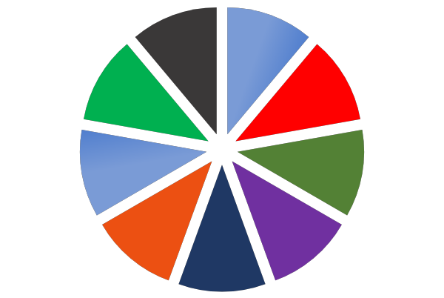
The 9 Growth Aspects
Growth Aspect | Aspect Description
Process Improvement | Operations, Work In Progress, Transactional Volume, Quality Control, Internal Statistics & Data Collection.
Customer Focus | Their Experience, (Our) Product / Service Delivery & Development.
Sales (Process) | Achieving Critical Revenue Objectives (consistently), Securing Resource, Managing Critical External Relations.
Authenticity | Values (Cultural), Marketing (Outbound Messaging), Aesthetics, ‘Feel’ (Vibe/Morale), Packaging.
Inventory & Equipment | Consumable Stock, Materials or Supplies, Tools, Machinery, Vehicles, Non-Consumable Working Assets.
Team Focus | Skills Development, Internal Communication, Change Management, Recruitment, Knowledge Management, Rewards/ Incentives.
Innovation | Technology, Disruption, (External) Research & Development, Re-Invention.
Governance | Vision, Strategic Planning, Sound Decision (Financial) Making Process, Leadership, Communication Lines, Financial Management, Risk Management.
Harmony / Balance | Removing Distractions, Health & Fitness, ‘Well-Being’, Recovering (Financial also).
Process
Improvement
Harmony / Balance
Governance
Customer Focus
Innovation
Sales
Team Focus
Authenticity
Inventory &
Equipment

Slide 21
Growth Fundamentals Framework (Overlapping Components)
9 Growth Stages | 5 Complexity Layers (+Psyche Errors) | 7 Growth Focus Tactics
1. Design | Foundation (Confirmation Bias) | Enthusiasm & Creativity
2. Launch
3. Break-even
4. Lifestyle | Orientation (Complacency) | Clarity & Strategy
5. Leverage | Intelligence (Optimism Bias) | Delegation, Replication and Quantification
6. Reach |  | Market Extension & Product Divergence
7. Leapfrog | Expansion (Mere-Exposure Effect) | Alliance & Acquisition
8. Maturity |  | Presence & Scale
9. Exit/Decline | Succession (Over Identification) | Realisation

Slide 22
Lite Fundamentals vs. Growth Fundamentals Framework
Q: What’s the difference between the Growth Fundamentals Framework and the ‘Lite’ Fundamentals Framework?
A: The Growth Fundamentals Framework is more comprehensive and therein, more complicated. The ‘Full’ version is designed to assist the consultant to establish a common framework for multiple advisers to provide assistance to the client, on a layered (leveraged) basis. The ‘Full’ version is supported by an online ‘tool-box’ that contains more than 100 templates and of course, requires considerable effort for an adviser to become familiar with. Additionally, the Growth Fundamentals Framework includes the 9 Growth Aspects which provides an extensive investigation of the Operational Objectives of the business to ensure a balanced, holistic approach to growth.
The sales process for the ‘Full’ version is based on a total needs basis and is aimed at larger, more complex business circumstances. The sales process generally involves 3-5 meetings, takes upwards of 10 hours to complete and is seeking work in the $30k+ fee range.
The ‘Lite’ version is based on the same ‘contextual’ theory but is focused on limiting the scope of the engagement. The engagement scope is limited for 3 key reasons;
Maintains the focused ‘domains for discussion’ to make it easier (and therefore more effective) for both the adviser and client. This enables advisers to become active with their clients in just 3 weeks.
Reduces the sales process to just 1 meeting and lowers the fee range to clients that could not afford the ‘full’ service suite.
Builds the confidence and experience of both the adviser and client as it establishes a framework for working together over many years to come. In time, the ‘Full’ version may well be applied.

Slide 23
Get Organised |  | Get the Job |  | Do the Job
Planning | Data | Marketing | Selling | People | Process
Get Organised
Get Organised
Lite Planning
Lite Data
Aligning Owner Expectations with the Business Model.
Knowing What Matters.
Lite Process
Lite Marketing
Making Improvements,
Step by Step.
Who You Want to Speak to,
What You Want to Say.
Do the Job
Get the Job
Lite People
Lite Sales
Getting the Most Out of the People You’ve Got.
Do the Job
Get the Job
Winning Business
The Lite Fundamentals Components

Slide 24
Growth Fundamentals ‘Lite’ Programme (year/level 1)
Planning | Collaborative Thinking Strategic Language Review 4 Box Planning Theory Business Owner Contrast Models Development Stages Contrast
Data | Working Capital Cycle 3 Uses of Profits Common Lingo & Ratios Managing Your Cash-flow Selecting KPI’s (Lead & Lag)
Sales | Matching the Sales Arena Congruent Positioning 4 Stages in Psychology of Sale Flowcharting Your Tension Points Holes, not drill bits
Marketing | Customer Profile & Needs Review 4 Levels of Consumer Awareness Modern Marketing Funnel 3 Key Marketing Statements 1 Page Marketing Plan
Planning & Data (Financial Management) | Sales & Marketing
Hurdles | People & Process (Operations)
Spare | Problem of the day...
Spare | Problem of the day...
People | 5 Drivers of Human Output Proven Feedback Model 3 Key Sociology Lessons 80/20 of Team Motivation 3 Keys to Creative Leadership
Process | Dave Nave Systems Comparison Process Improvement Cycle Process Design

Slide 25
Planning
Data
Orientation / Desires
Revenue model / Scale
Bizz Threats/ Opportunity
Organisational structure
Values & Risk appetite
Collect, Compile, Verify
Assimilate, Report
Model, Forecast, Scenario planning & Prediction
Process
Marketing
People Effectiveness
Reliability / Consistency
Systems interdependency
Business Improvements
Client Segmentation
Focused messaging
Brand recognition
Market Analytics
People
Sales
Staff engagement
Staff proximity / locations
Skills development
Leadership / Morale
Internal communication
Staffing numbers/divisions
Enquiry conversion
Customer/Client relations
Point of sale feedback re- product/service appeal & competitor perceptions.

Slide 26
Planning
Data
Orientation / Desires
Revenue model / Scale
Bizz Threats/ Opportunity
Organisational structure
Values & Risk appetite
Collect, Compile, Verify
Assimilate, Report
Model, Forecast, Scenario planning & Prediction
Clarity of targets
Value chain/drivers
New actions to be tested
Transactional Volume
Job profitability
Reduced overheads
Less wastage/errors
Leveraged activities
Prioritise actions
Focus Marketing activity
Quantify actions
Confirm understanding
Allocate resources
Process
System
Marketing
People Effectiveness
Reliability / Consistency
Systems interdependency
Business Improvements
“A set of things working together as parts of a mechanism or an interconnecting network; a complex whole.”
Client Segmentation
Focused messaging
Brand recognition
Market Analytics
Input
Output
# Jobs completed
Job timeliness
Job accuracy
Job extensions
Relationships secured
Phone enquiries
Customer walk ins
Online requests
Online purchases
Greater receptivity to sales activities
People
Sales
Staff engagement
Staff proximity / locations
Skills development
Leadership / Morale
Internal communication
Staffing numbers/divisions
Enquiry conversion
Customer/Client relations
Point of sale feedback re- product/service appeal & competitor perceptions.
# of Sales
Avg’ Sale Value
Repeat Purchases
Conversion ratios
Shortened sales time

